Slide 1
Vuejs-D02
PartOne:
- calling for methods , registeration for events : () , call without ()
- $event=> event object
- computed property : vs reactive proeprties , vs methods : call method inside {{}}
- computed property : as method , object (set , get => validate values before assigning for one of reactive properties)
- life cycle hooks : beforeCcreate , created , beforemount , mounted , beforeUpdate , updated , beforeUnmount , unmounted
- template : “template ”
- v-cloak : incase late for mount process
- form binding : demo
Parttwo :
vue-cli : build prject using structure for vue projects : components , SFC : .vue (3 parts , template , style , script (instane for this module ))
- build parent component (contains set of components ) : how to include component nside another one : SPA

Slide 2
Computed property
Define as method and we use it as property inside template
define it within computed clause in vue instance

Slide 3
Vue instance hook life cycle hooks
beforeCreate(): observation events and properties , never to use this hook for assigning any value any property
Created : you can here assign values for reactive properties
Beforemount : compilation for template <p>{{message}}</p> => <p>helloworld</p> in memory
Mounted : render : html page
Beforeupdate :
Updated :
beforeDestroy => vue2.0 => beforeUnmout
Destroyed => vue2.0=> unmounted

Slide 4
Data : loaded from any source : static
Categories:[“”,””,””]
Checkbox
Select , option
Display this data in form controls

Slide 5
P02 : vue cli : command line interface
Create project vuejs with vue js structure : components , entry point control main component : mounting within html page ,
….
Routing
……….
Single page application
Spa
One html page :
Display all content ,
Component

Slide 6
Vue-cli steps
1- npm I –g @vue/cli
2- available in your terminal use vue command : create project
terminal : vue create project name
- ask you about presets : options :
3- structure : public , src (assets , components , main.js(entry point ))

Slide 7
To create component
Single file component :
SFC
.vue
File.vue
Any component : constructed from 3 parts
- template : html
- script : logic : instance , data , method ,…
- style : applied for this component

Slide 8
We want to replace app.vue with our component wrappercomponent (root component | maincomponent)
wrappercomponent
headercomponent
linkscomponent
bodyscomponent
footercomponent

Slide 9
To use component x inside component y y will host x (parent is y) , x is child component
Steps :
1- import child component inside parent component
import x inside y
2- regiter child component inside parent component
using components option inside parent instance
3- use child component inside parent as html tag

Slide 10
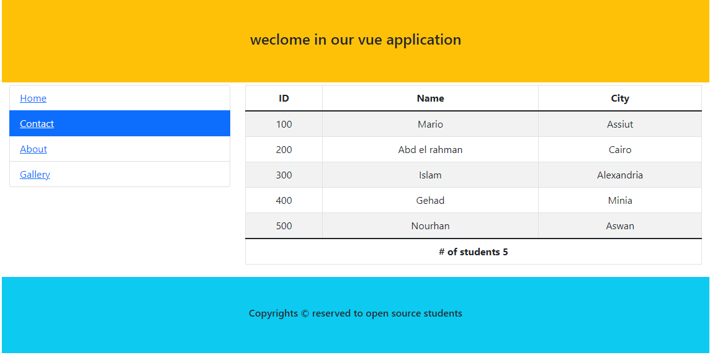
Tasks : 1 form binding : with bs validation
Push for new object in students array
tasktwo
Open modal dialog bs
Receive name , city
add
cancel
add
dismisser

Slide 11
Task three
Demo one for lecture one :
Online shopping demo :
- Create it as one component

